Slide 1



Bridging Technology and Care: The AI-powered Medical Device Challenge for Older Persons
Emeritus Prof. Kwan Hoong Ng, PhD, FASc, FIUPESM
Department of Biomedical Imaging, Univ Malaya
Adjunct Prof. Monash University Malaysia
ngkh@ummc.edu.my
Nov 13 2024

Slide 2
Disclosure of Conflicts of Interest
I have no potential conflicts of interest to declare with regards to this presentation.

Slide 3
With contribution from
Dr Shier Nee Saw, PhD
Universiti Malaya, Malaysia
Prof Maw Pin Tan, MRCP, MD
Universiti Malaya, Malaysia

Slide 4
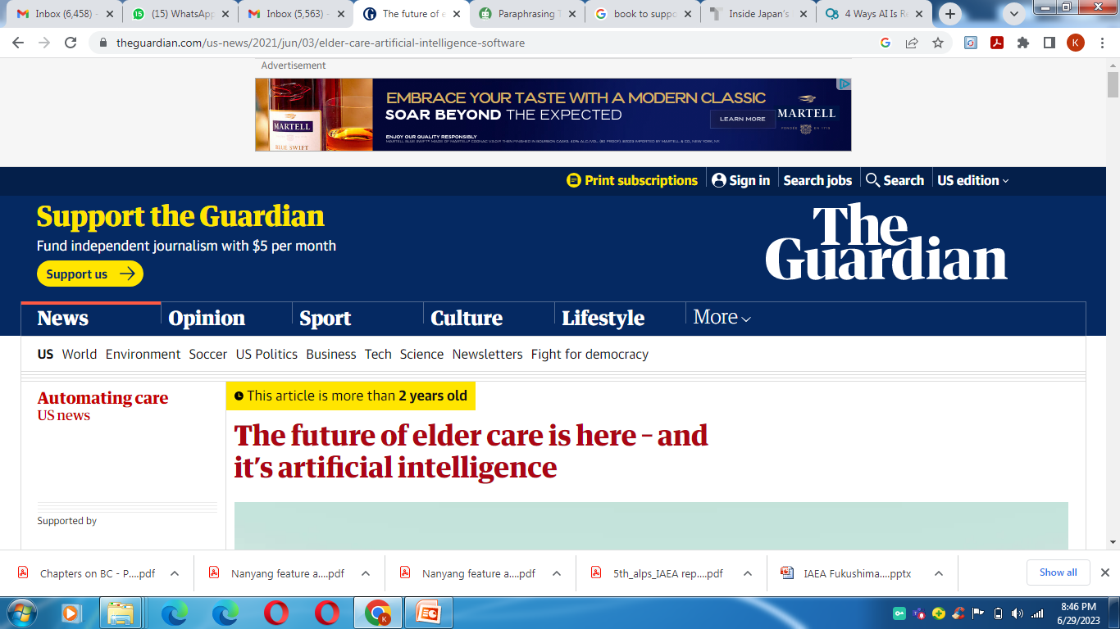
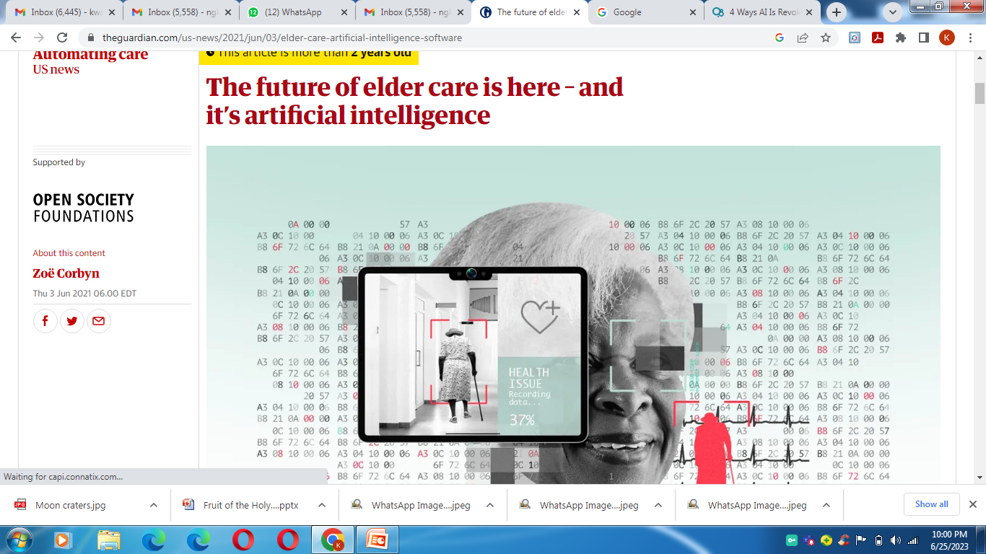
https://www.theguardian.com/us-news/2021/jun/03/elder-care-artificial-intelligence-software
Notes:
https://www.theguardian.com/us-news/2021/jun/03/elder-care-artificial-intelligence-software

Slide 5
We will discuss
1. The Older Persons
2. AI-powered Medical Devices for Older Persons
3. Challenges of integrating AI in Healthcare for Older Persons
4. AI for Health of Older Persons
- the WHO Perspectives

Slide 6
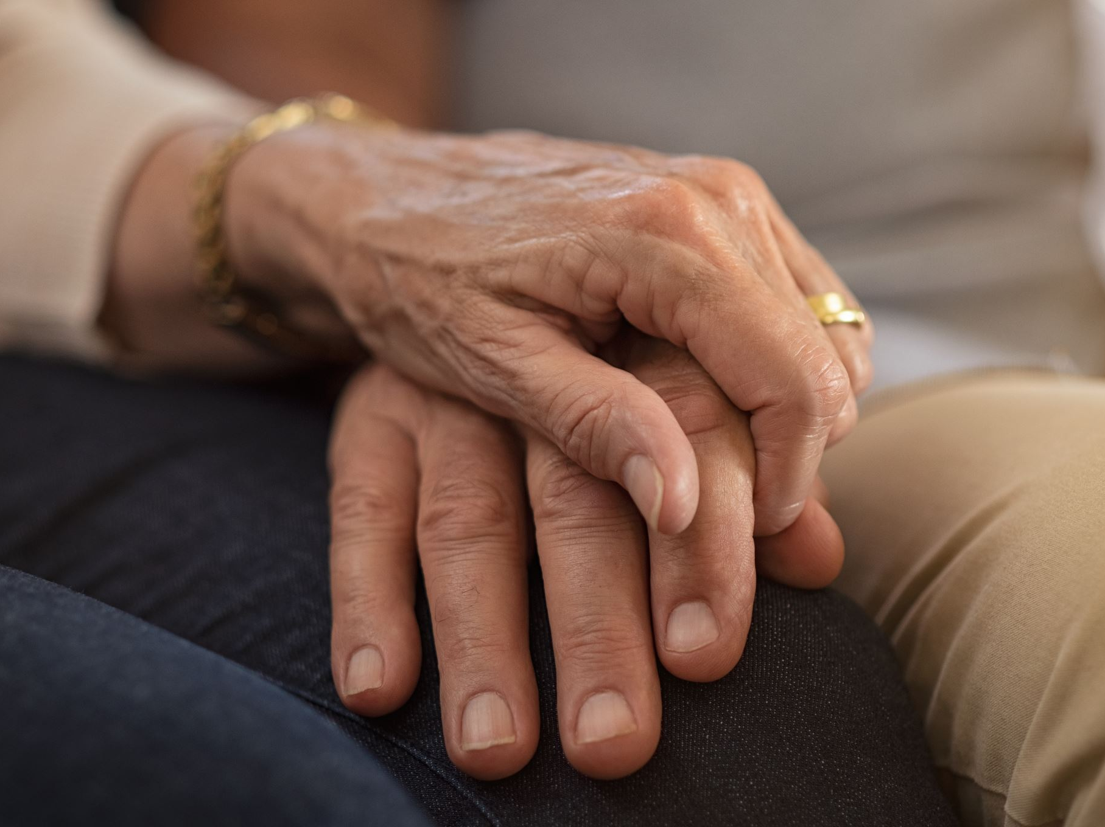
1. The Older Persons

Slide 7
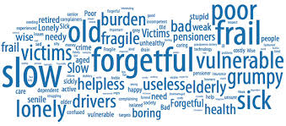
What come to your mind when we mention ‘Older People’?
https://seniorcommunity.org/how-we-speak-about-older-adults-can-enable-ageism/
Notes:
https://seniorcommunity.org/how-we-speak-about-older-adults-can-enable-ageism/

Slide 8
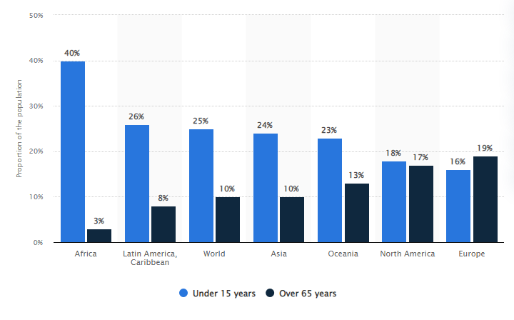
Proportion of selected age groups of world population and in regions in 2022

Slide 9
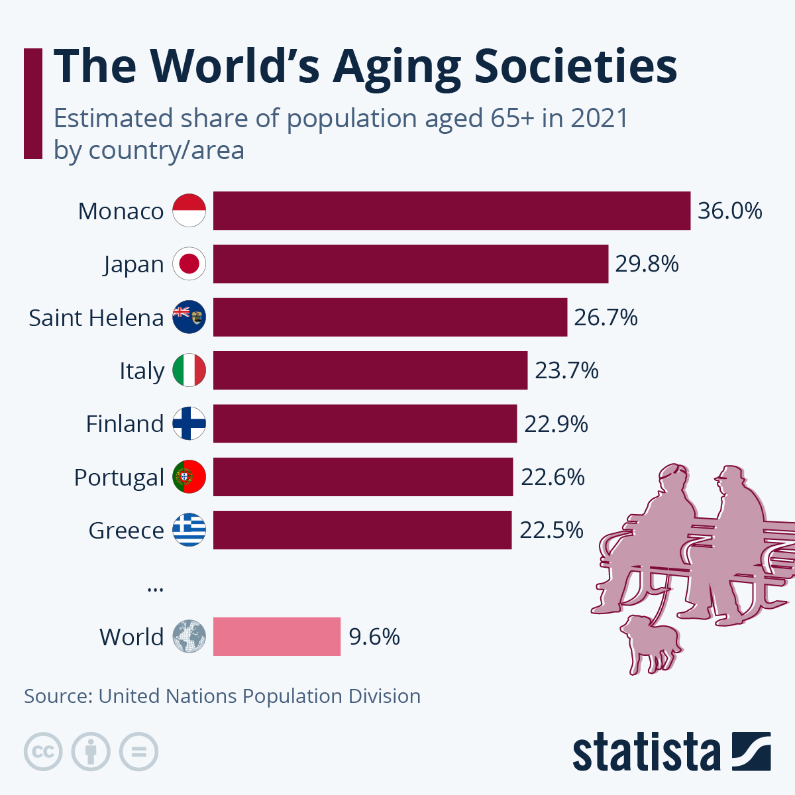
Notes:
https://www.statista.com/chart/28319/estimated-share-of-population-aged-65--by-country/?gclid=Cj0KCQjw1_SkBhDwARIsANbGpFsuZzFZlMhWHd4NuTnoorP6QlQ3yvOpSLfbD6bRvKAZ7VHIJRtLMjIaAhG9EALw_wcB

Slide 10
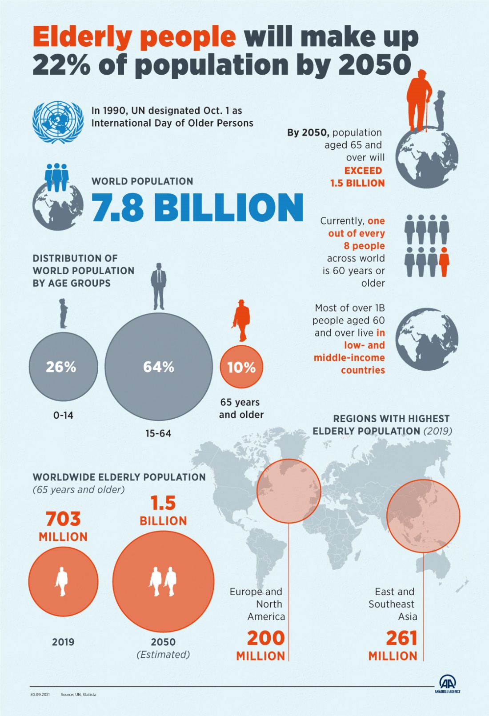
https://www.aa.com.tr/en/life/elderly-to-make-up-22-of-world-population-by-2050/2379462
Notes:
https://www.aa.com.tr/en/life/elderly-to-make-up-22-of-world-population-by-2050/2379462

Slide 11
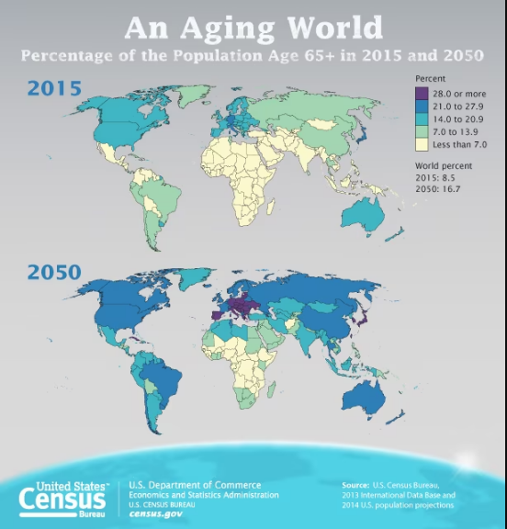
https://www.census.gov/content/dam/Census/library/visualizations/2016/comm/cb16-54_graphic.jpg
Notes:
https://www.census.gov/content/dam/Census/library/visualizations/2016/comm/cb16-54_graphic.jpg

Slide 12
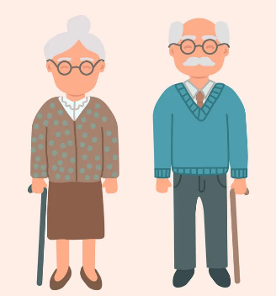
Major Problems of Older Persons
Physical
Cognitive
Emotional
Social

Slide 13
Common health issues faced by the older persons
Arthritis
Heart diseases
Cancer
Respiratory diseases
Alzheimer’s disease
Osteoporosis
Diabetes
Influenza and pneumonia
Falls
Substance abuse
Obesity
Depression
Parkinson
Notes:
https://www.everydayhealth.com/news/most-common-health-concerns-seniors/

Slide 14
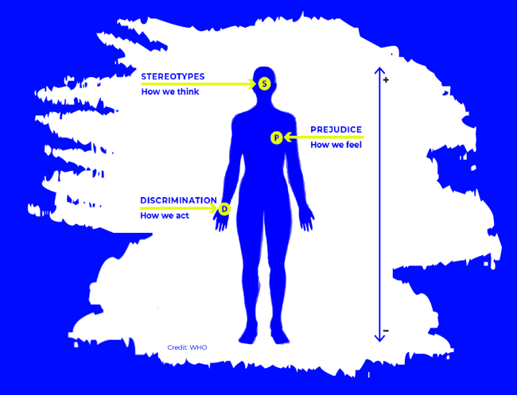
Ageism refers to how we think (stereotypes), feel (prejudice) and act (discrimination) towards others or ourselves based on age.
discriminación por edad
l'âgisme
年龄歧视
WHO Global report on ageism

Slide 15
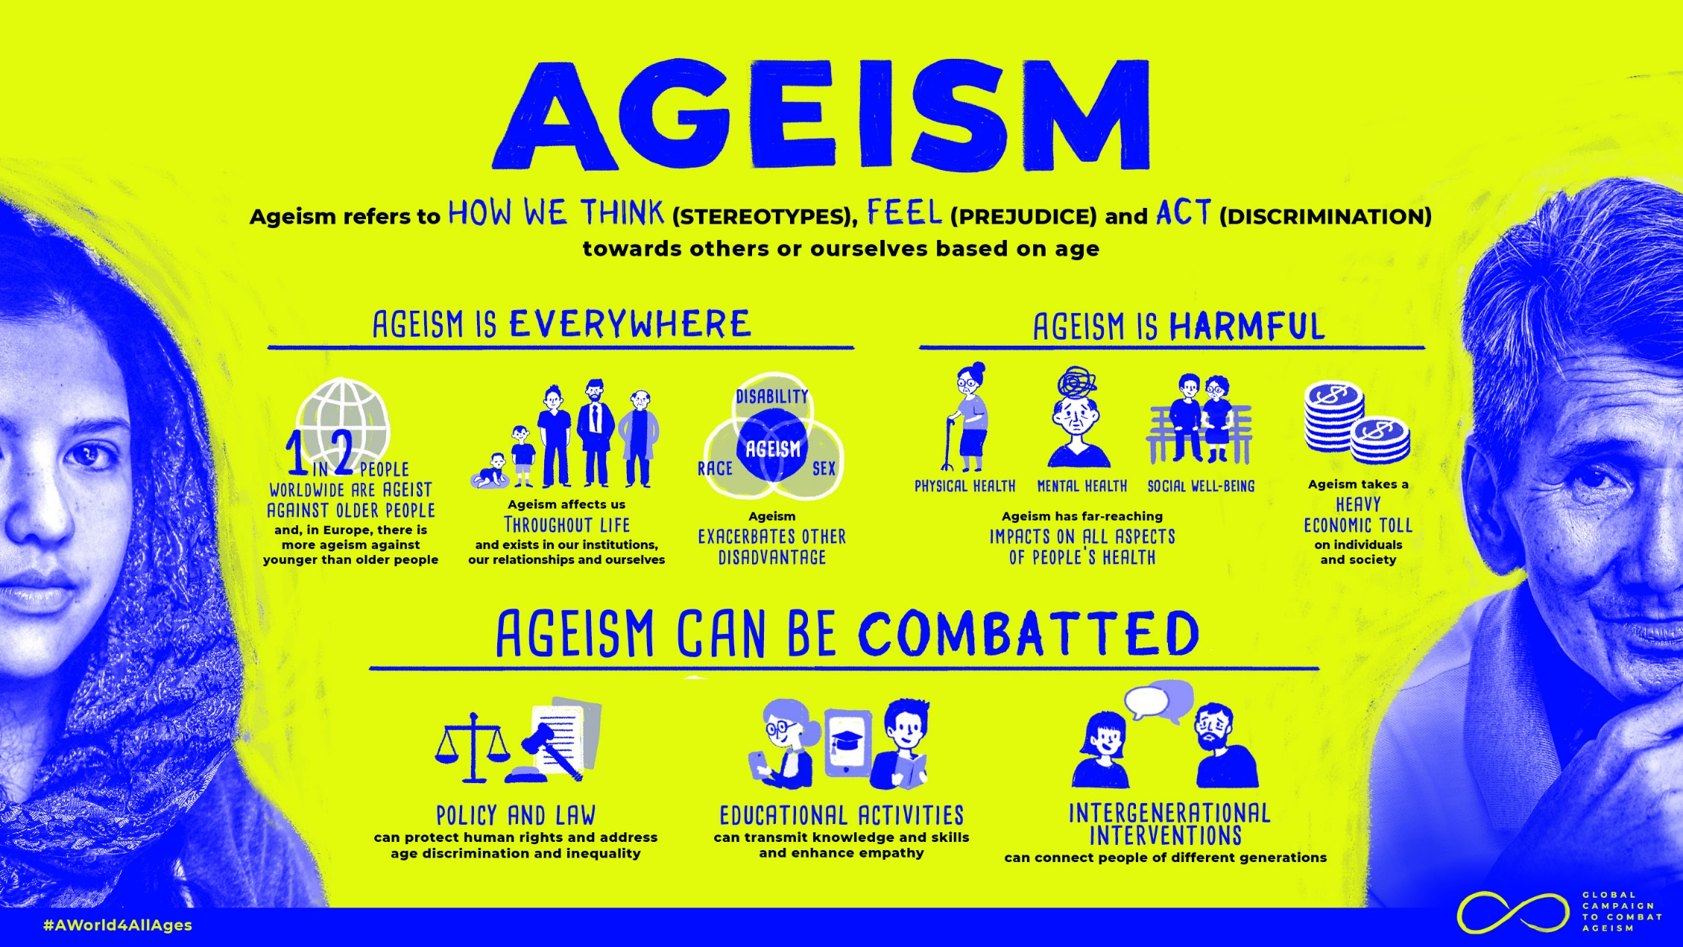
https://www.who.int/teams/social-determinants-of-health/demographic-change-and-healthy-ageing/combatting-ageism/global-report-on-ageism
Notes:
https://www.who.int/teams/social-determinants-of-health/demographic-change-and-healthy-ageing/combatting-ageism/global-report-on-ageism

Slide 16
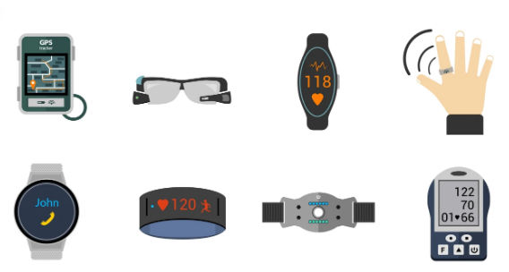
2. AI-Powered
Medical Devices for Older Persons

Slide 17
WHO definition of medical devices
Medical devices include all the health technologies (except for vaccines and medicines) required for prevention, diagnosis, treatment, monitoring, rehabilitation and palliation. They are indispensable for universal health coverage, monitoring wellbeing and addressing outbreaks or emergencies.

Slide 18
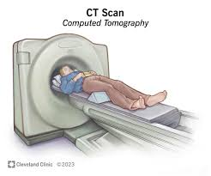
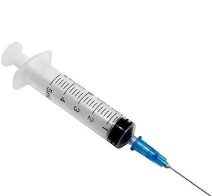
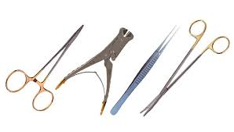
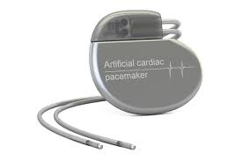
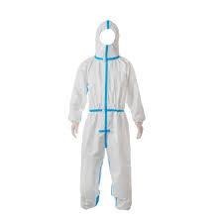
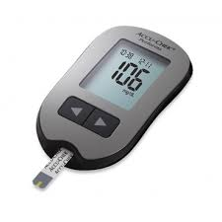

Categories of medical devices
single use devices
implantable
imaging
medical equipment
software
in vitro diagnostics
personal protective equipment
surgical and laboratory instruments
Notes:
single use devices (i.e. syringes, catheters)
implantable (i.e. hip prothesis, pacemakers)
imaging (i.e. ultrasound and CT scanners)
medical equipment (i.e. anesthesia machines, patient monitors, hemodialysis machines)
software (i.e. computer aided diagnostics)
in vitro diagnostics (i.e. glucometer, HIV tests)
personal protective equipment (i.e. mask, gowns, gloves)
surgical and laboratory instruments

Slide 19
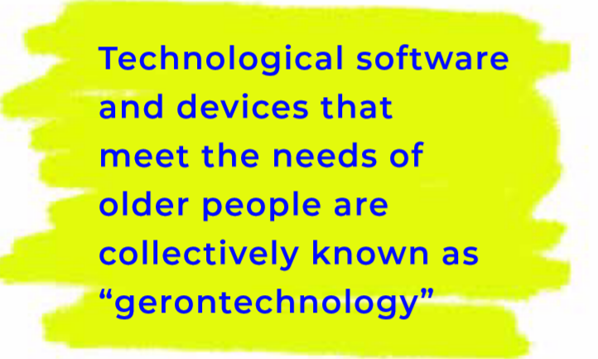
Ageism in artificial intelligence for health: WHO policy brief
Notes:
Ageism in artificial intelligence for health: WHO policy brief
Mannheim I, Schwartz E, Xi W, Buttigeig SC, McDonnell-Naughton M, Wouters EJM, van Zaalen Y. Inclusion
of older adults in the research and design of digital technology. Int J Environ Res Public Health. 2019;16:3718
(doi:10.3390/ijerph16193718).

Slide 20
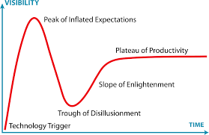
Gartner’s Hype Cycle is a graphical prediction of a common pattern that arises with each new technology or other innovation

Slide 21
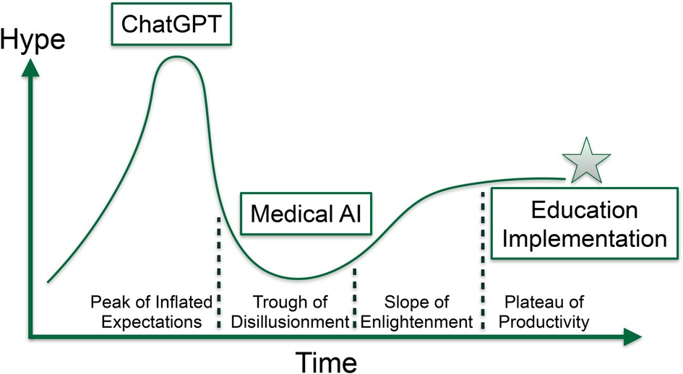
Levy et al Front. Med. Technol., June 2023
https://www.frontiersin.org/articles/10.3389/fmedt.2023.1206969/full
Notes:
https://www.frontiersin.org/articles/10.3389/fmedt.2023.1206969/full

Slide 22
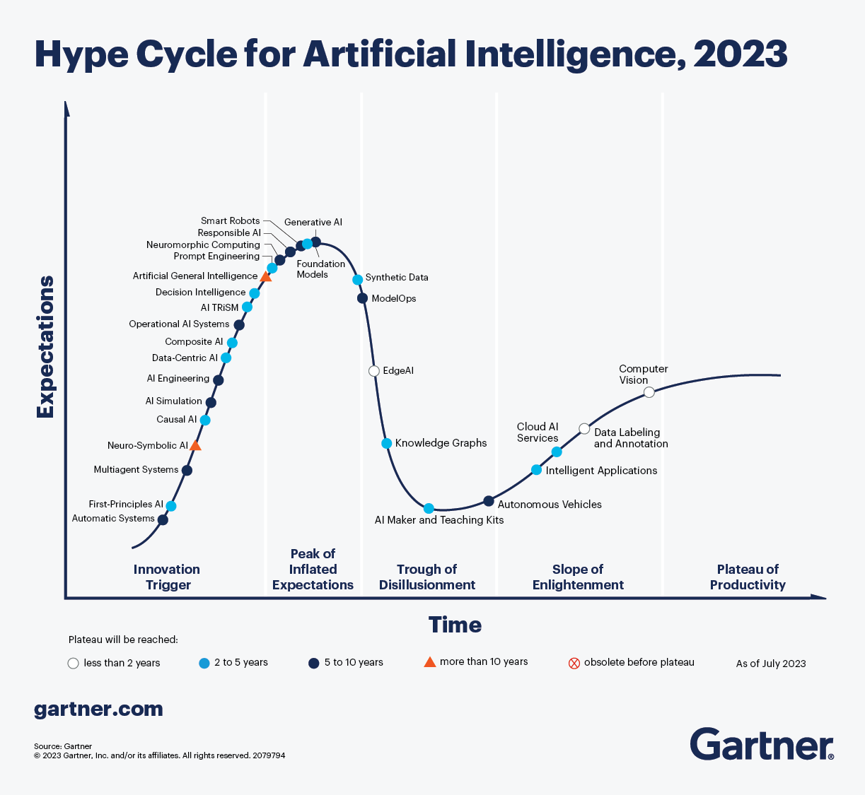
Notes:
https://www.gartner.com/en/articles/what-s-new-in-artificial-intelligence-from-the-2023-gartner-hype-cycle

Slide 23
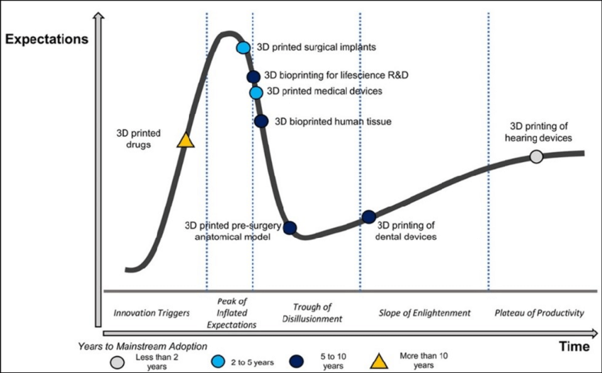
Notes:
https://www.researchgate.net/figure/2-Gartners-Hype-Curve-for-AM-in-biomedical-related-applications-44_fig5_350856787/download?_tp=eyJjb250ZXh0Ijp7ImZpcnN0UGFnZSI6Il9kaXJlY3QiLCJwYWdlIjoiX2RpcmVjdCJ9fQ

Slide 24

Beyond the Hypes: AI in medical devices

Slide 25
Roles of AI technologies in elderly healthcare 1/2
Rehabilitation therapists
Emotional supporters
Social facilitators
Supervisors
Cognitive promoters
Notes:
Ma 2023

Slide 26
Functions of AI technologies in elderly healthcare 2/2
Rehabilitation
Social interaction
Companionship and support
Cognitive training
Alerting and monitoring
Notes:
Ma 2023

Slide 27
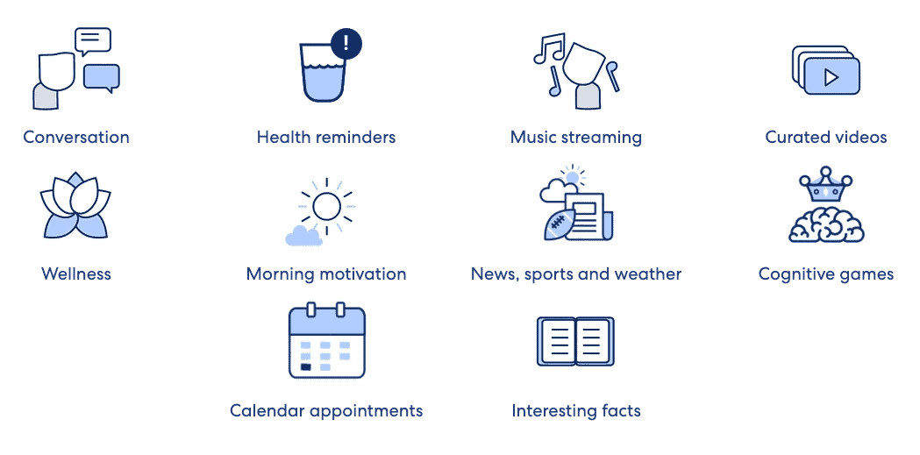
https://mindsea.com/ai-senior-care/
Notes:
https://mindsea.com/ai-senior-care/

Slide 28
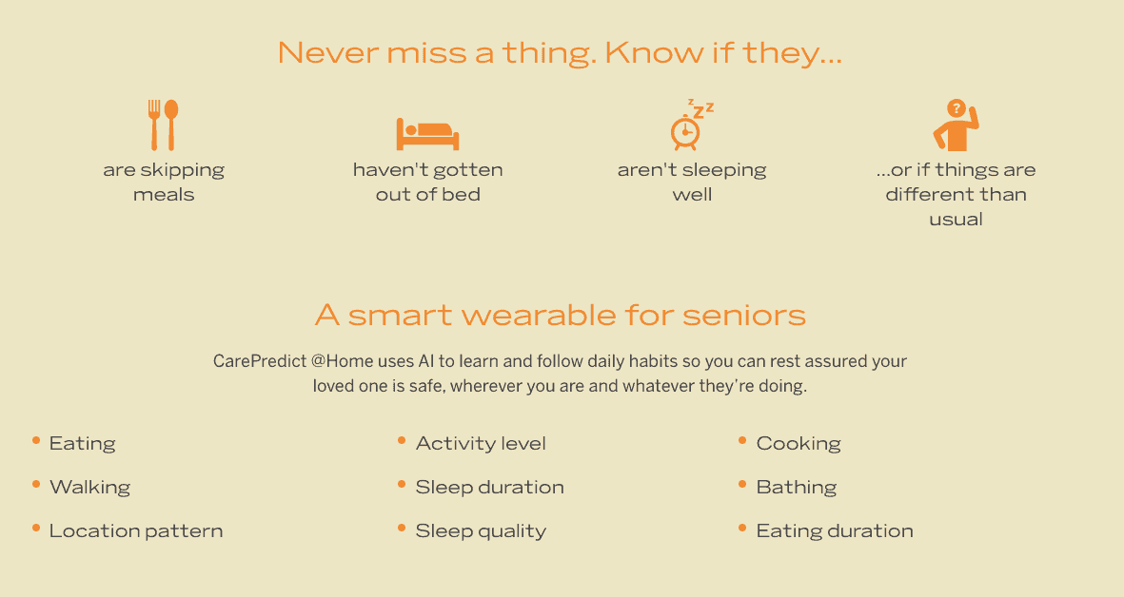
https://mindsea.com/ai-senior-care/

Slide 29
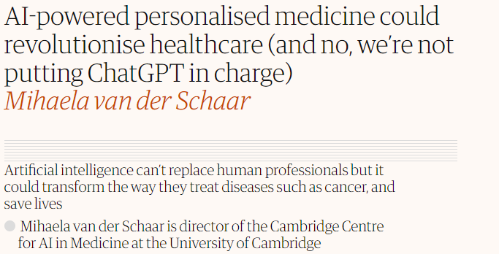
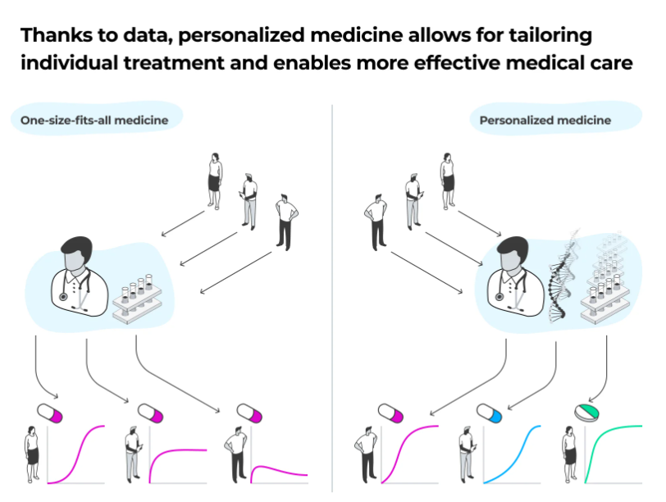
Personalized Treatment
Notes:
https://www.theguardian.com/commentisfree/2023/jun/26/ai-personalise-medicine-patient-lab-health-diagnosis-Cambridge
https://www.softeq.com/blog/precision-medicine-ai-and-big-data-use-cases-in-healthcare

Slide 30
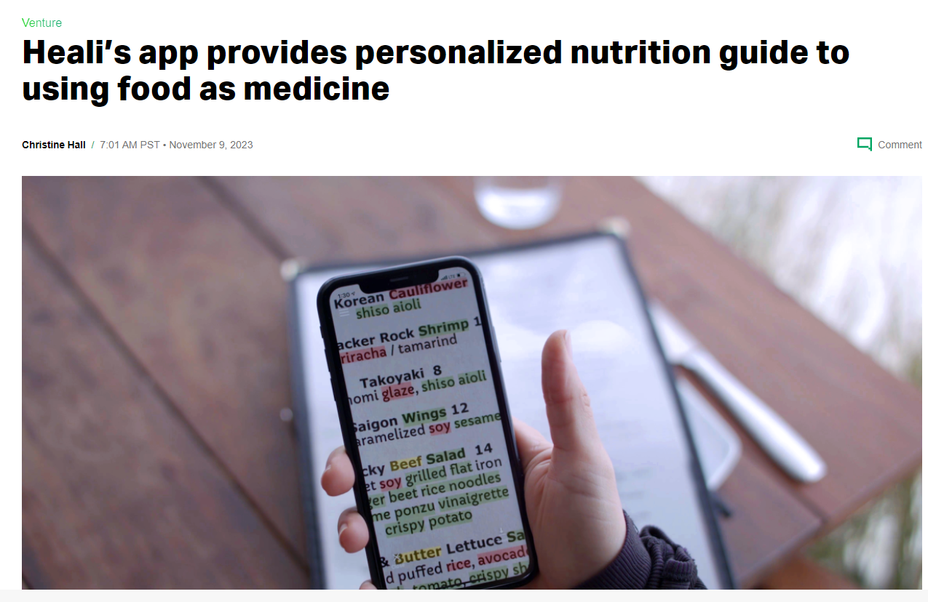
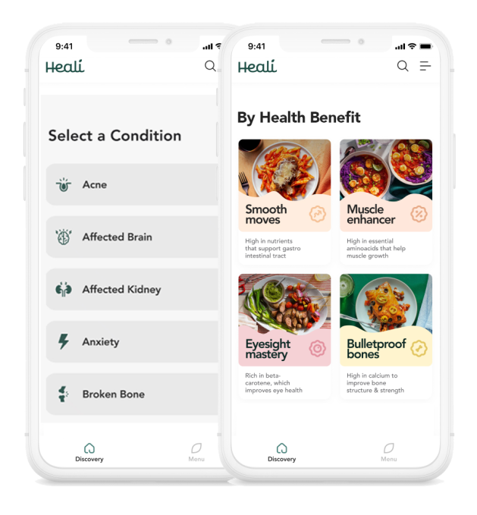
Notes:
https://techcrunch.com/2023/11/09/heali-app-personalized-nutrition-food-as-medicine/

Slide 31
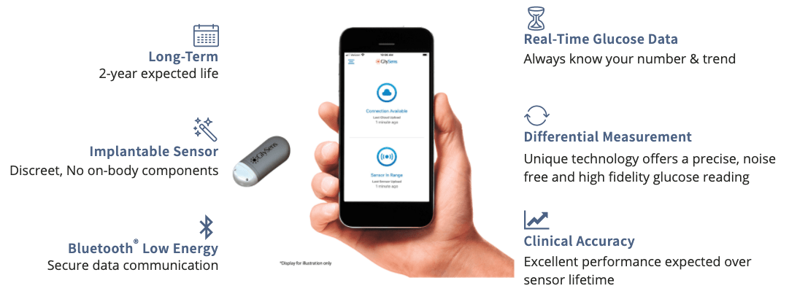
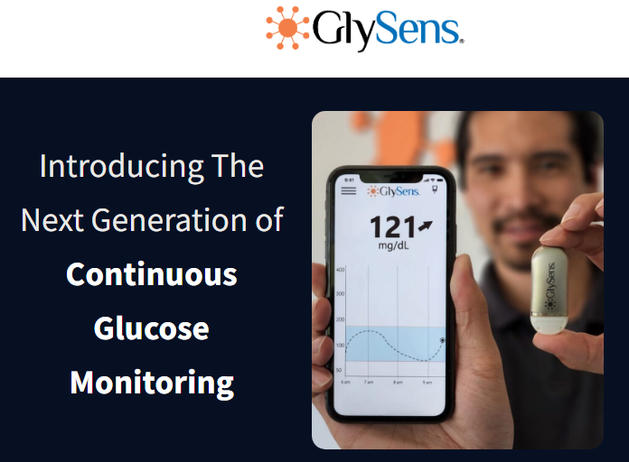
Smart Implant
Monitoring and Support
https://mindsea.com/ai-senior-care/

Slide 32
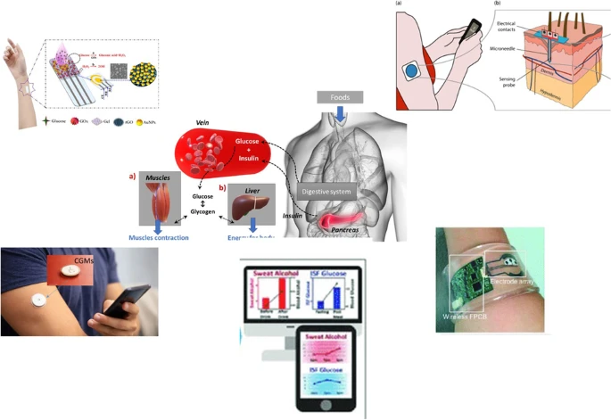
Insight into continuous glucose monitoring: from medical basics to commercialized devices. Microchim Acta 190, 177 (2023).
https://link.springer.com/article/10.1007/s00604-023-05743-w
Notes:
https://link.springer.com/article/10.1007/s00604-023-05743-w

Slide 33
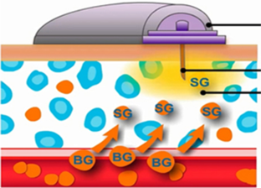
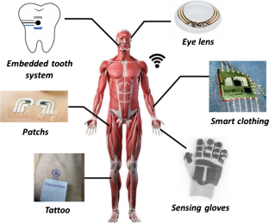
https://link.springer.com/article/10.1007/s00604-023-05743-w
Notes:
BG blood glucose SG sensor glucose

Slide 34
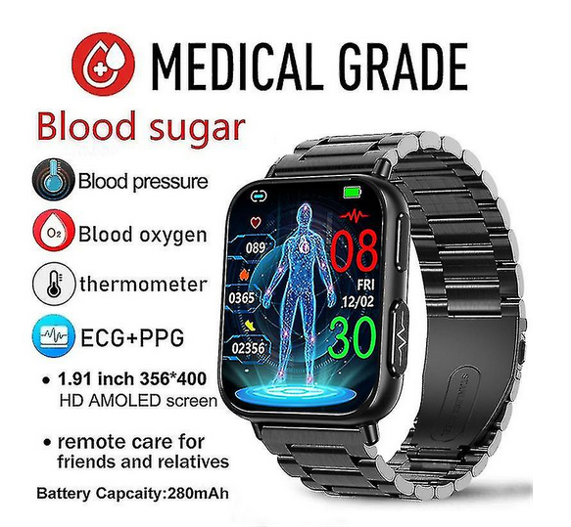
Wearable device + Predictive Analytics
Notes:
https://www.fruugo.my/2023-new-blood-sugar-smartwatch-men-191-inch-365400-hd-screen-ecgppg-smart-watch-monitoring-non-invasive-blood-glucose-watch-newway/p-245727389-529600727?language=en&ac=google&gad_source=1&gclid=Cj0KCQjwu8uyBhC6ARIsAKwBGpTu9i41_oB-_QKLiHdSY-qyY7vl4noowHmQOmBhDwJV78b3f9nun6oaAq16EALw_wcB

Slide 35
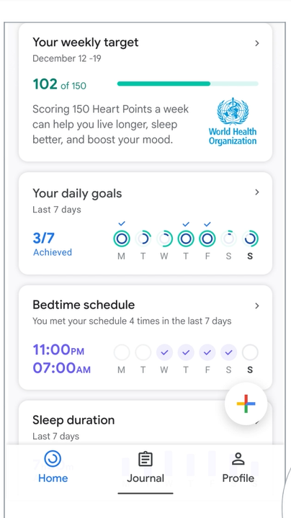
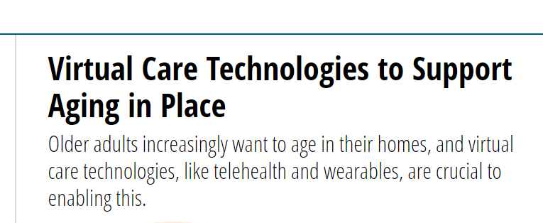
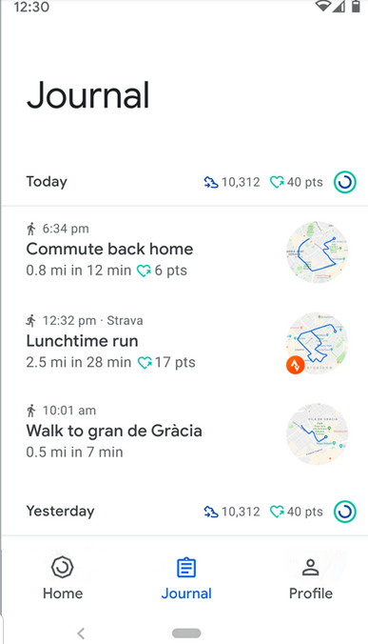
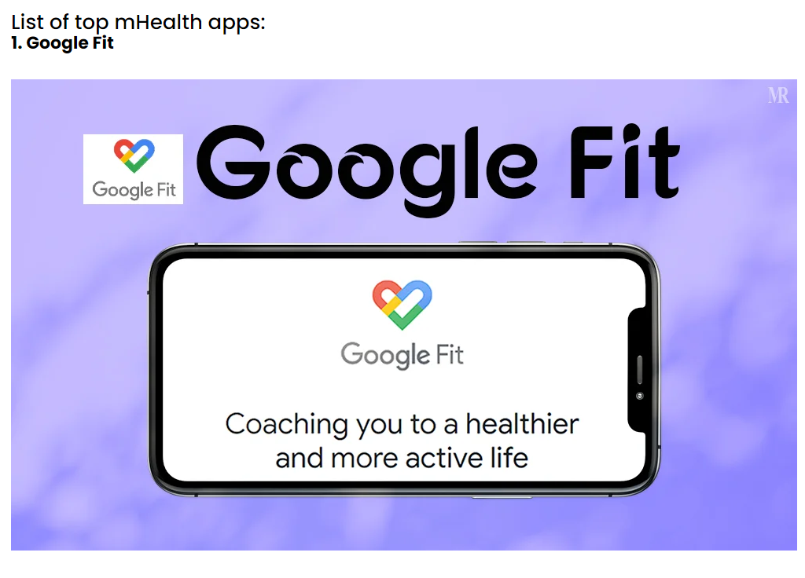

Slide 36
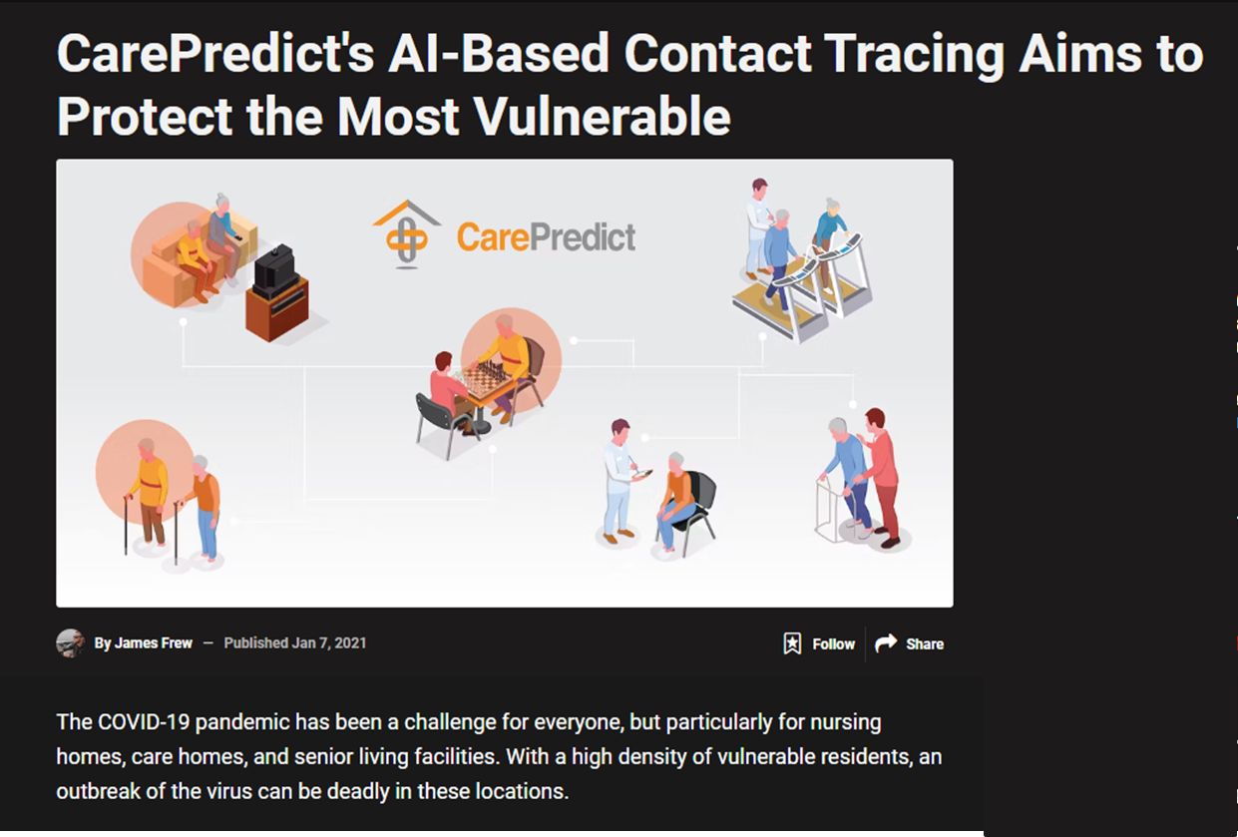
Fall Detection and Prevention
uses AI to enable fall detection and subsequently alerts caregivers or medical professionals if there is a fall.
Notes:
https://www.makeuseof.com/carepredicts-ai-based-contact-tracing-aims-to-protect-the-most-vulnerable/

Slide 37
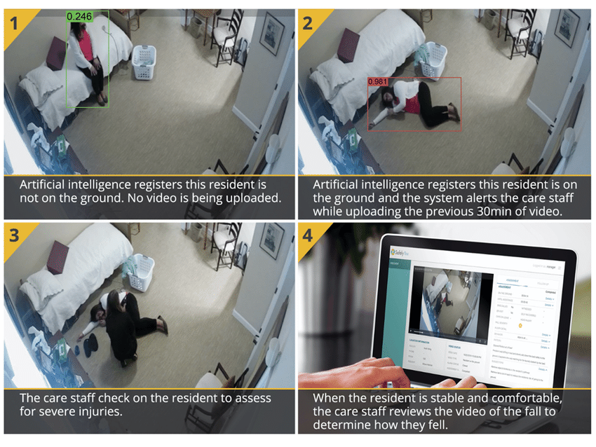
Fall Detection and Prevention
Notes:
https://www.makeuseof.com/carepredicts-ai-based-contact-tracing-aims-to-protect-the-most-vulnerable/

Slide 38
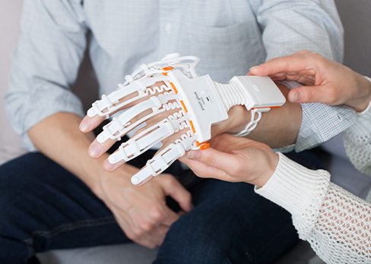
Rehab: Neofect Smart Glove
Function: Rehabilitation device for stroke patients.
Use: The glove uses AI to track hand movements and provides interactive exercises to improve motor function during rehabilitation.
https://www.neofect.com/us/smart-glove

Slide 39
3. Challenges of Integrating AI in Healthcare for Older

Slide 40
Digital Literacy:
Many older persons may not be familiar with technology or feel comfortable using it, that can hinder them to interact with AI-driven healthcare systems effectively.
Provide training and user-friendly interfaces.

Slide 41
2. Data Privacy and Security:
Older persons may be concerned about the privacy and security of their health data, especially in AI systems that use sensitive personal information.
Ensure compliance with regulations like HIPAA (Health Insurance Portability and Accountability Act-USA) and other relevant regulations.

Slide 42
3. Bias in AI Algorithms:
AI algorithms can inherit biases in the data they are trained on, leading to differences in health outcomes for older persons, esp. affecting minority, marginalized, or underrepresented groups.
Ensure diversity in training data set and minimize bias.

Slide 43
4. Trust:
Older persons may be skeptical or reluctant to trust AI-powered healthcare recommendations (this is because they cannot understand how AI arrived at its conclusions.)
Ensure transparency and explainability of AI algorithms.

Slide 44
5. Adaptation to Individual Needs:
Older adults have diverse (and sometimes peculiar) health needs and preferences, requiring AI systems to be adaptable and personalized.
Tailor AI-driven interventions to individual health condition, social-economic status, and preferences.

Slide 45
4. AI for Health of Older People – the WHO Perspectives

Slide 46
Ageism refers to how we think (stereotypes), feel (prejudice) and act (discrimination) towards others or ourselves based on age.
discriminación por edad
l'âgisme
年龄歧视
WHO Global report on ageism 2021
WHO

Slide 47



Slide 48
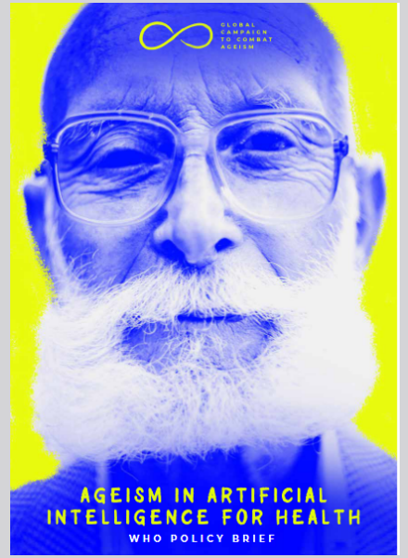
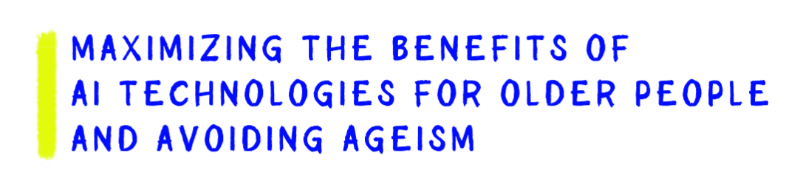
Ageism in artificial intelligence for health: WHO policy brief
https://www.who.int/publications/i/item/9789240040793
Notes:
https://www.who.int/publications/i/item/9789240040793

Slide 49
“To ensure that AI technologies play a beneficial role, ageism must be identified and eliminated from their design, development, use, and evaluations.” - Ageism in artificial intelligence for health: WHO policy brief

Slide 50
These eight considerations could ensure that AI technologies for health address ageism and that older people are fully involved in the processes, systems, technologies and services that affect them.
Participatory design of AI technologies, and evaluations by and with older people
Age-diverse data science team
Age-inclusive data collection
Investments in digital infrastructure and digital literacy for older people and their health-care providers and caregivers
Rights of older people to consent and contest
Governance frameworks and regulations to empower
and work with older people
7. Increased research
8. Robust ethics processes
https://www.who.int/publications/i/item/9789240040793

Slide 51
3. Age-inclusive data collection
AI developers should ensure that AI data are accurate, complete and diverse, including according to age
If older people, is underrepresented in a dataset, that group might be oversampled relative to its size to ensure high quality results.
Data cooperatives – ensure adequate data collection; setting standards

Slide 52
4. Investments in digital infrastructure and digital literacy for older people and their health-care providers and caregivers
Lack of digital infrastructure - may contribute to the prevailing ageist belief that older people do not use digital (or AI) technologies and therefore need not be accounted for.
e.g. when AI technologies are used in patient monitoring, older people must be informed what is being monitored and for what purpose, who will use the information and the possible implications for their daily lives
Healthcare providers must keep up with AI advances, continuing education

Slide 53
8. Robust ethics processes
A robust ethics process is necessary to guide the development and application of AI systems for older people.
Impact assessment - information on possible consequences and risks (both positive and negative), improve decision-making, transparency and public participation in decision-making.

Slide 54
Bridging Technology and Care: The AI-powered Medical Device Challenge for Older Persons

Slide 55
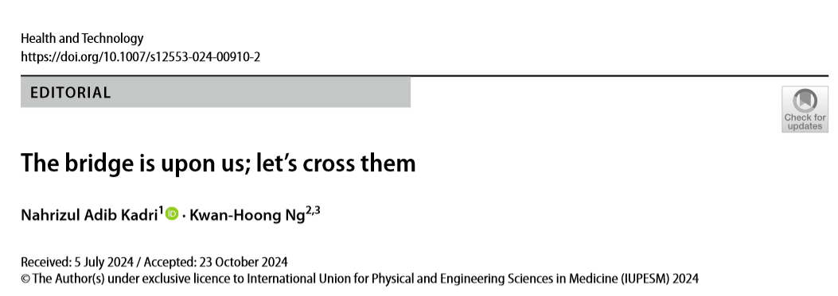
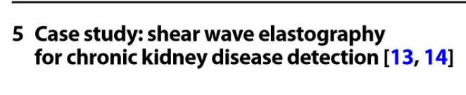
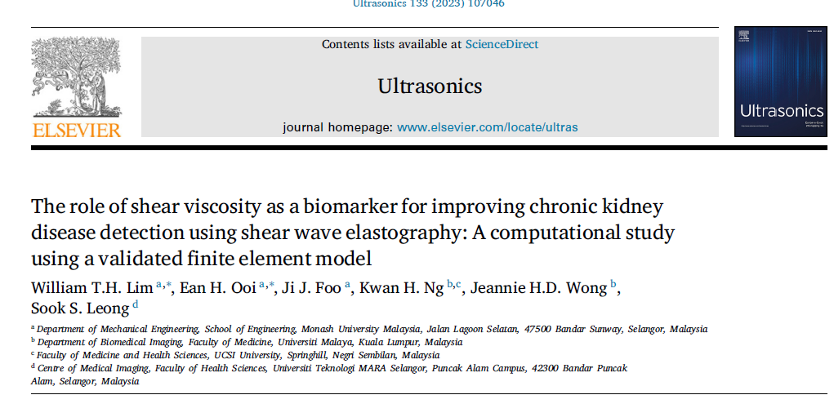

Slide 56
“To achieve more, we should imagine together and change.”
Make a difference

Slide 57


